Slide 1


Team Name:
Project Title:
Name of the Student | Roll No. | Department
@ KONE ELEVATORS
1

Slide 2
ABSTRACT
The project is an optimised vibration isolation system to reduce vibration propagation and structural resonance in high-speed elevators. A 4-DOF mass-spring-damper model is created in MATLAB to investigate the vibration transmission in the system composed of the traction machine, guide rails, and elevator cabin to building structure. The system performs natural frequency, resonance and dynamic vibration response analyses for various excitation frequencies. The vibration problem of the traction machine is considered and an optimal spring-damper mounting structure is proposed to reduce excessive vibration. An automatic optimisation algorithm, which will calculate the suitable stiffness and damping coefficients by comparing the vibration response of cabin and building, will be developed. The proposed method will be designed to reduce the transmission of vibrations, prevent critical resonance, increase the comfort of the elevator and increase the dynamic performance of elevator structures, especially in ultra-high-rise structures.
Core finding
Resonance produces large acceleration peaks, while increased damping lowers cabin vibration and improves passenger comfort.
@ KONE ELEVATORS
2

Slide 3
PROPOSED SOLUTION
Four-degree-of-freedom vibration path
Optimised Spring-Damper Isolation System
Installed between traction machine base frame and supporting structure.
Spring provides elastic isolation.
Damper dissipates vibration energy.
Minimises vibration transmission.
1
Traction machine
External harmonic force
↓
2
Building structure
Model Inputs
Mass of each component
Connection stiffness
Damping coefficients
Harmonic excitation force
Elevator operating frequency
Support flexibility
↓
3
Guide rails
Rail stiffness and irregularity
↓
4
Elevator cabin
Passenger response
Simulation output
Natural frequencies • displacement • acceleration • damping response • speed sensitivity
@ KONE ELEVATORS
3

Slide 4
TECHNOLOGIES USED
M ẍ + C ẋ + K x = F(t)
x = [x1, x2, x3, x4]^T
System definition
MATLAB workflow
•
M: mass matrix for four moving components
•
Define m, k, c and excitation force
•
C: damping matrix for energy dissipation
•
Build M, C and K matrices
•
K: stiffness matrix for mechanical coupling
•
Find natural frequencies using eig(K,M)
•
F(t): harmonic force applied at the traction machine
•
Sweep excitation frequency from 0.5 to 40 Hz
•
Acceleration amplitude = ω² × displacement amplitude
•
Solve time response using ode45
•
Repeat for damping factors 0.5, 1 and 3
Key interpretation: resonance occurs when excitation frequency approaches one of the system natural frequencies.
@ KONE ELEVATORS
4

Slide 5
DIAGRAMS & SCHEMATICS
Mechanical coupling used in the simulation
Traction machine
Building structure
Guide rails
Elevator cabin
→
→
→
m₁ • external harmonic force
m₂ • structural flexibility
m₃ • rail stiffness and damping
m₄ • passenger response
Simulated responses
Displacement
Acceleration
Resonance peaks
Damping Response
@ KONE ELEVATORS
5

Slide 6
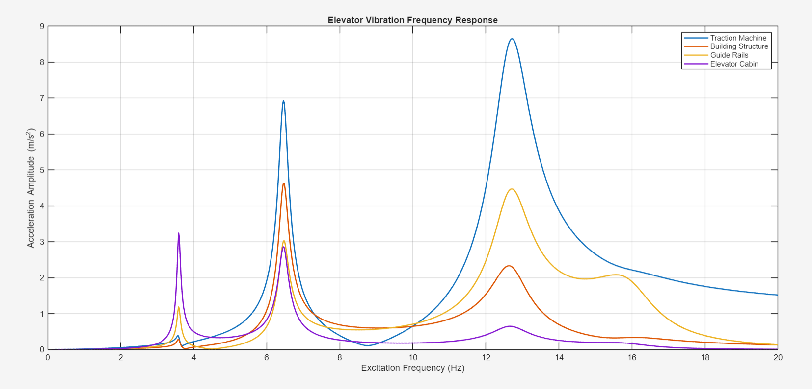
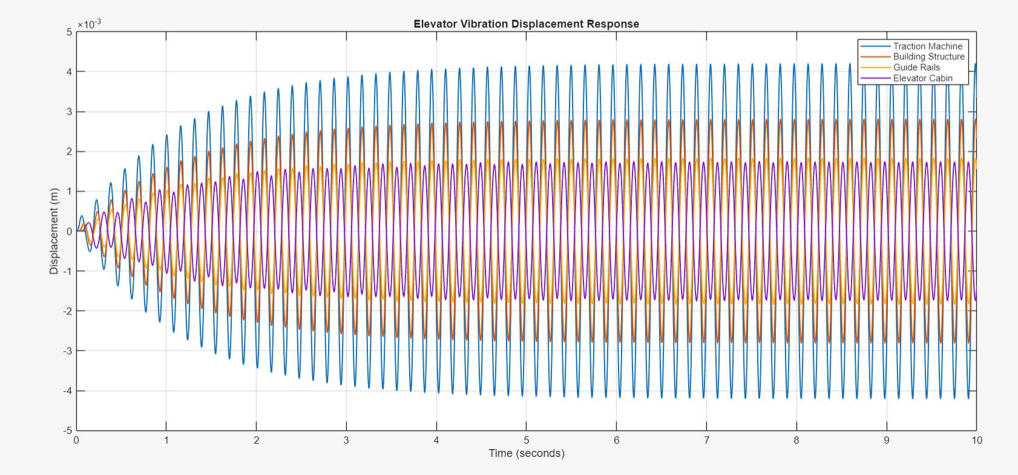
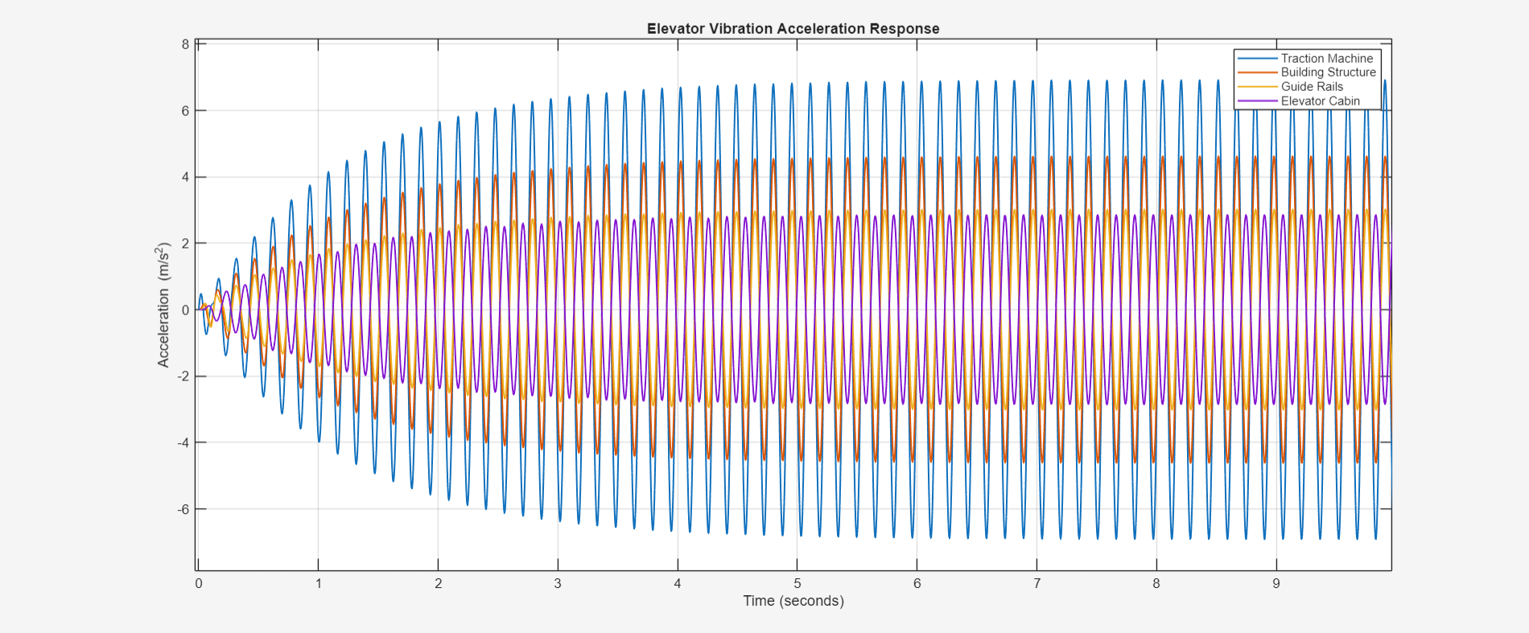
RESULTS
Frequency domain and time-domain analysis
What the plots show
•
Multiple resonance peaks indicate different vibration modes.
•
The traction machine exhibits a strong response near resonance.
•
Displacement and acceleration responses vary across elevator components.
•
Time-domain responses demonstrate transient and steady-state vibration behaviour.
@ KONE ELEVATORS
6

Slide 7
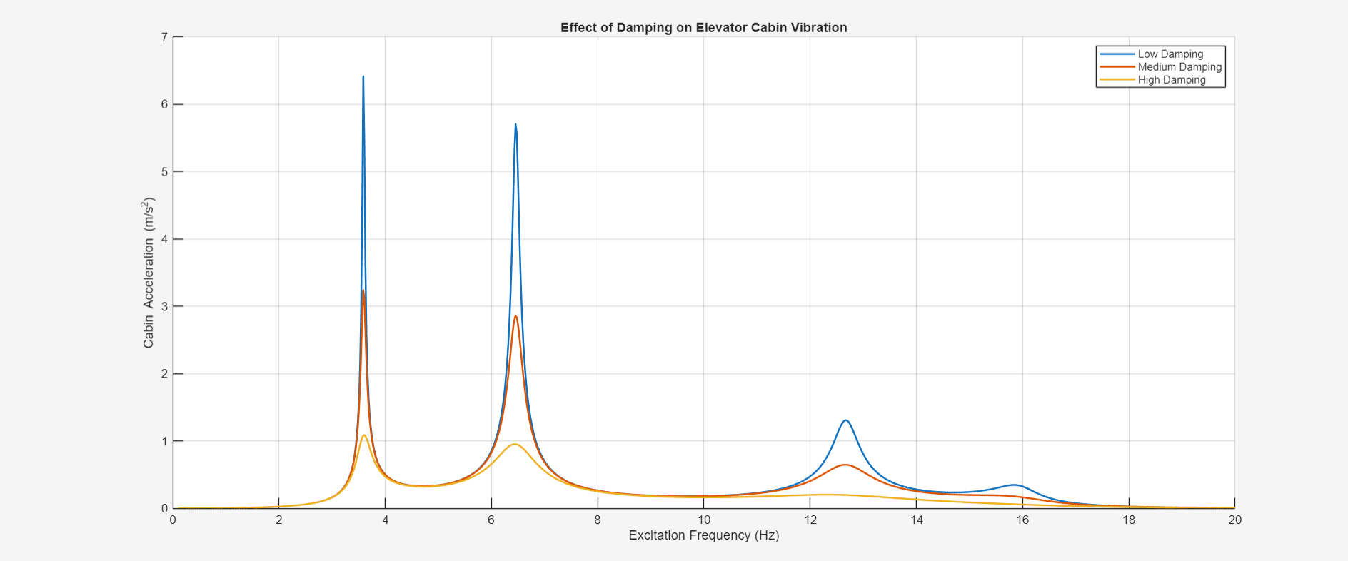
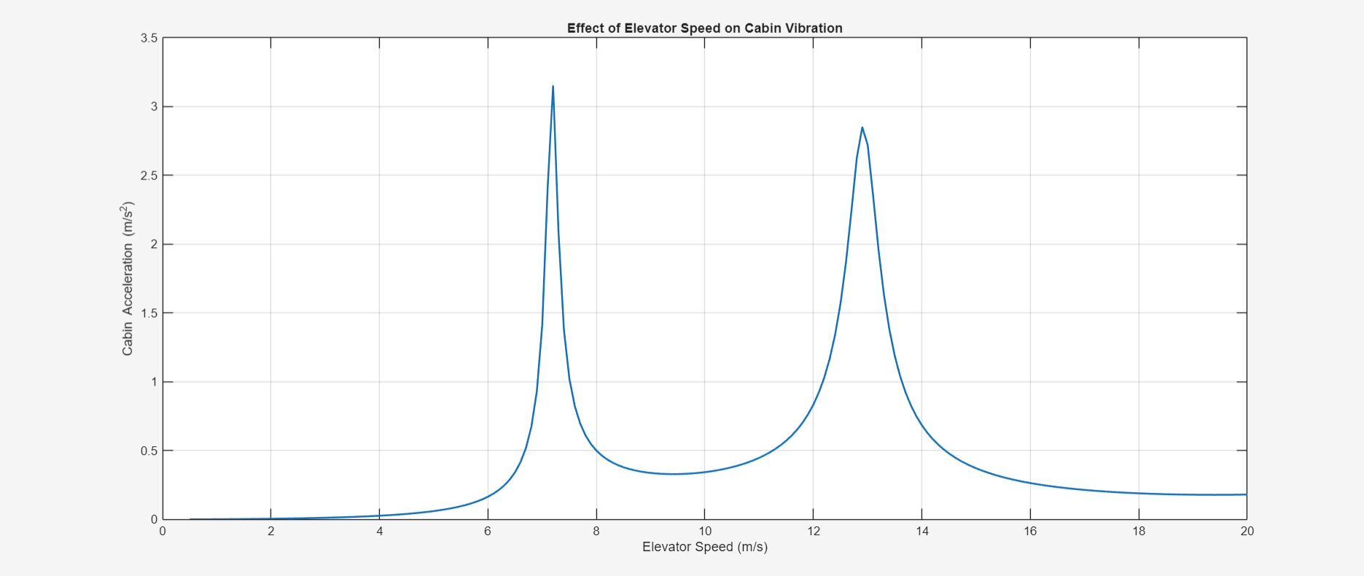
CONCLUSION
Key findings
•
Higher damping reduces resonance peaks and cabin acceleration.
•
Elevator speed can move the excitation frequency toward resonance.
•
The four-component model provides a clear vibration-propagation picture.
•
Future work: add ropes, counterweight, measured rail data and experimental validation.
Conclusion: resonance analysis and damping are central to controlling vibration and improving passenger comfort.
@ KONE ELEVATORS
7

Slide 8
BENEFITS
Key findings
•
Higher damping reduces resonance peaks and cabin acceleration.
•
Elevator speed can move the excitation frequency toward resonance.
•
The four-component model provides a clear vibration-propagation picture.
•
Future work: add ropes, counterweight, measured rail data and experimental validation.
Conclusion: resonance analysis and damping are central to controlling vibration and improving passenger comfort.
@ KONE ELEVATORS
7

Slide 9
FUTURE SCOPE
Key findings
•
Higher damping reduces resonance peaks and cabin acceleration.
•
Elevator speed can move the excitation frequency toward resonance.
•
The four-component model provides a clear vibration-propagation picture.
•
Future work: add ropes, counterweight, measured rail data and experimental validation.
Conclusion: resonance analysis and damping are central to controlling vibration and improving passenger comfort.
@ KONE ELEVATORS
7

